Slide 1
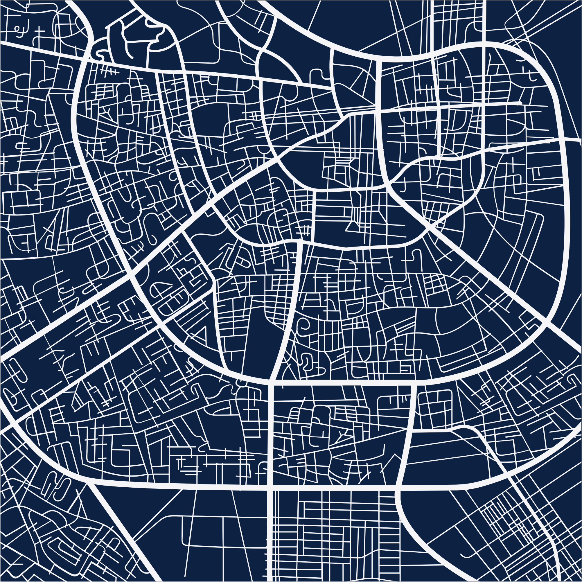
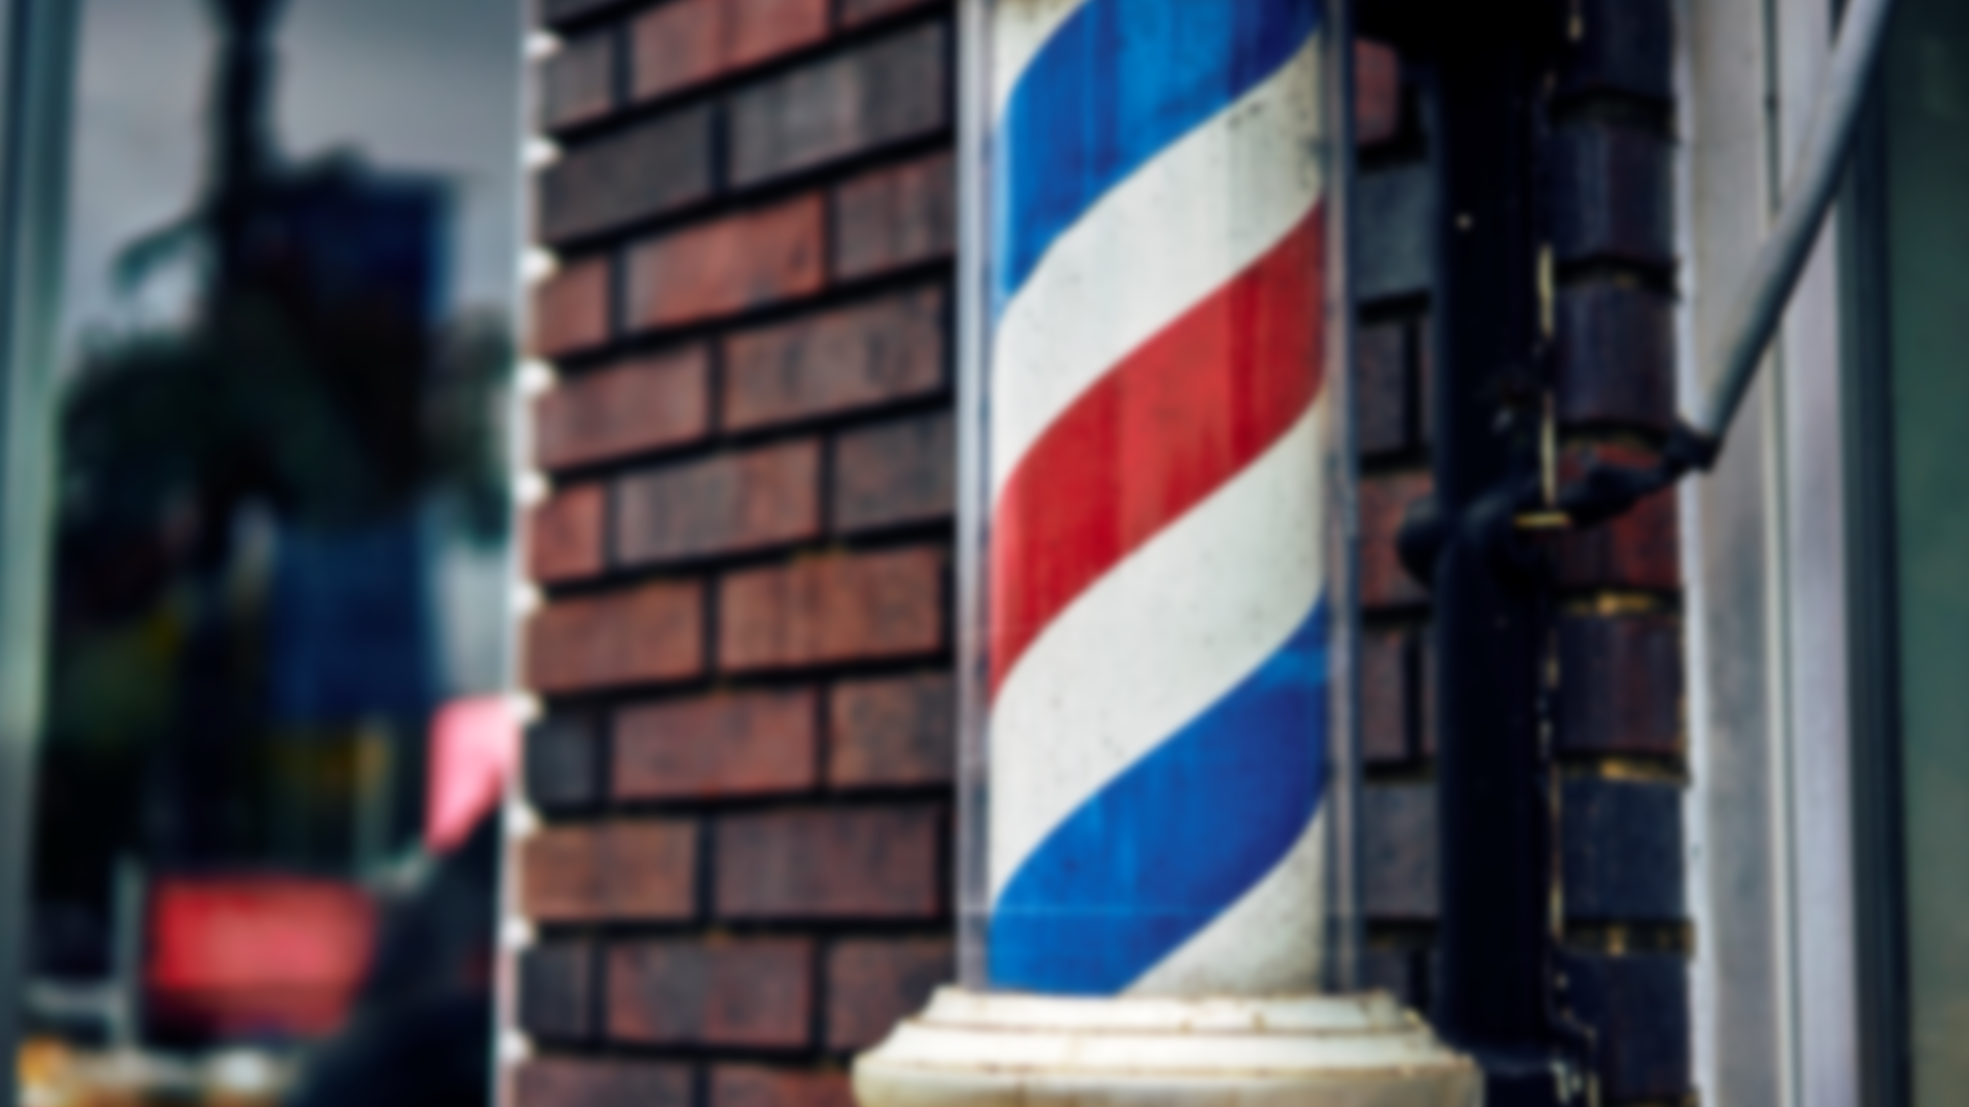

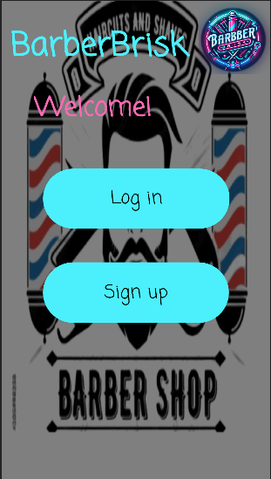
Get Haircut now!
BarberBrisk!

Slide 2
Our Partners
Elon Ezra
Avi Rahimov
Asaf Yekutiel
Dor Harizi
Team leader
Team member
Team member
Team member
Ratting system
DB design
Notification system
Implementing profile page of barber and client
Login page
Overall design of the app except for the barber
Writing the DB interface
Implementing a significant part of the client/barber functionality
Implementing the DB functions
Creating some of the objects
Creating the sign-up page
Something with queues
Designing the barber
Implementing the parcel object
Creating additional objects

Slide 3
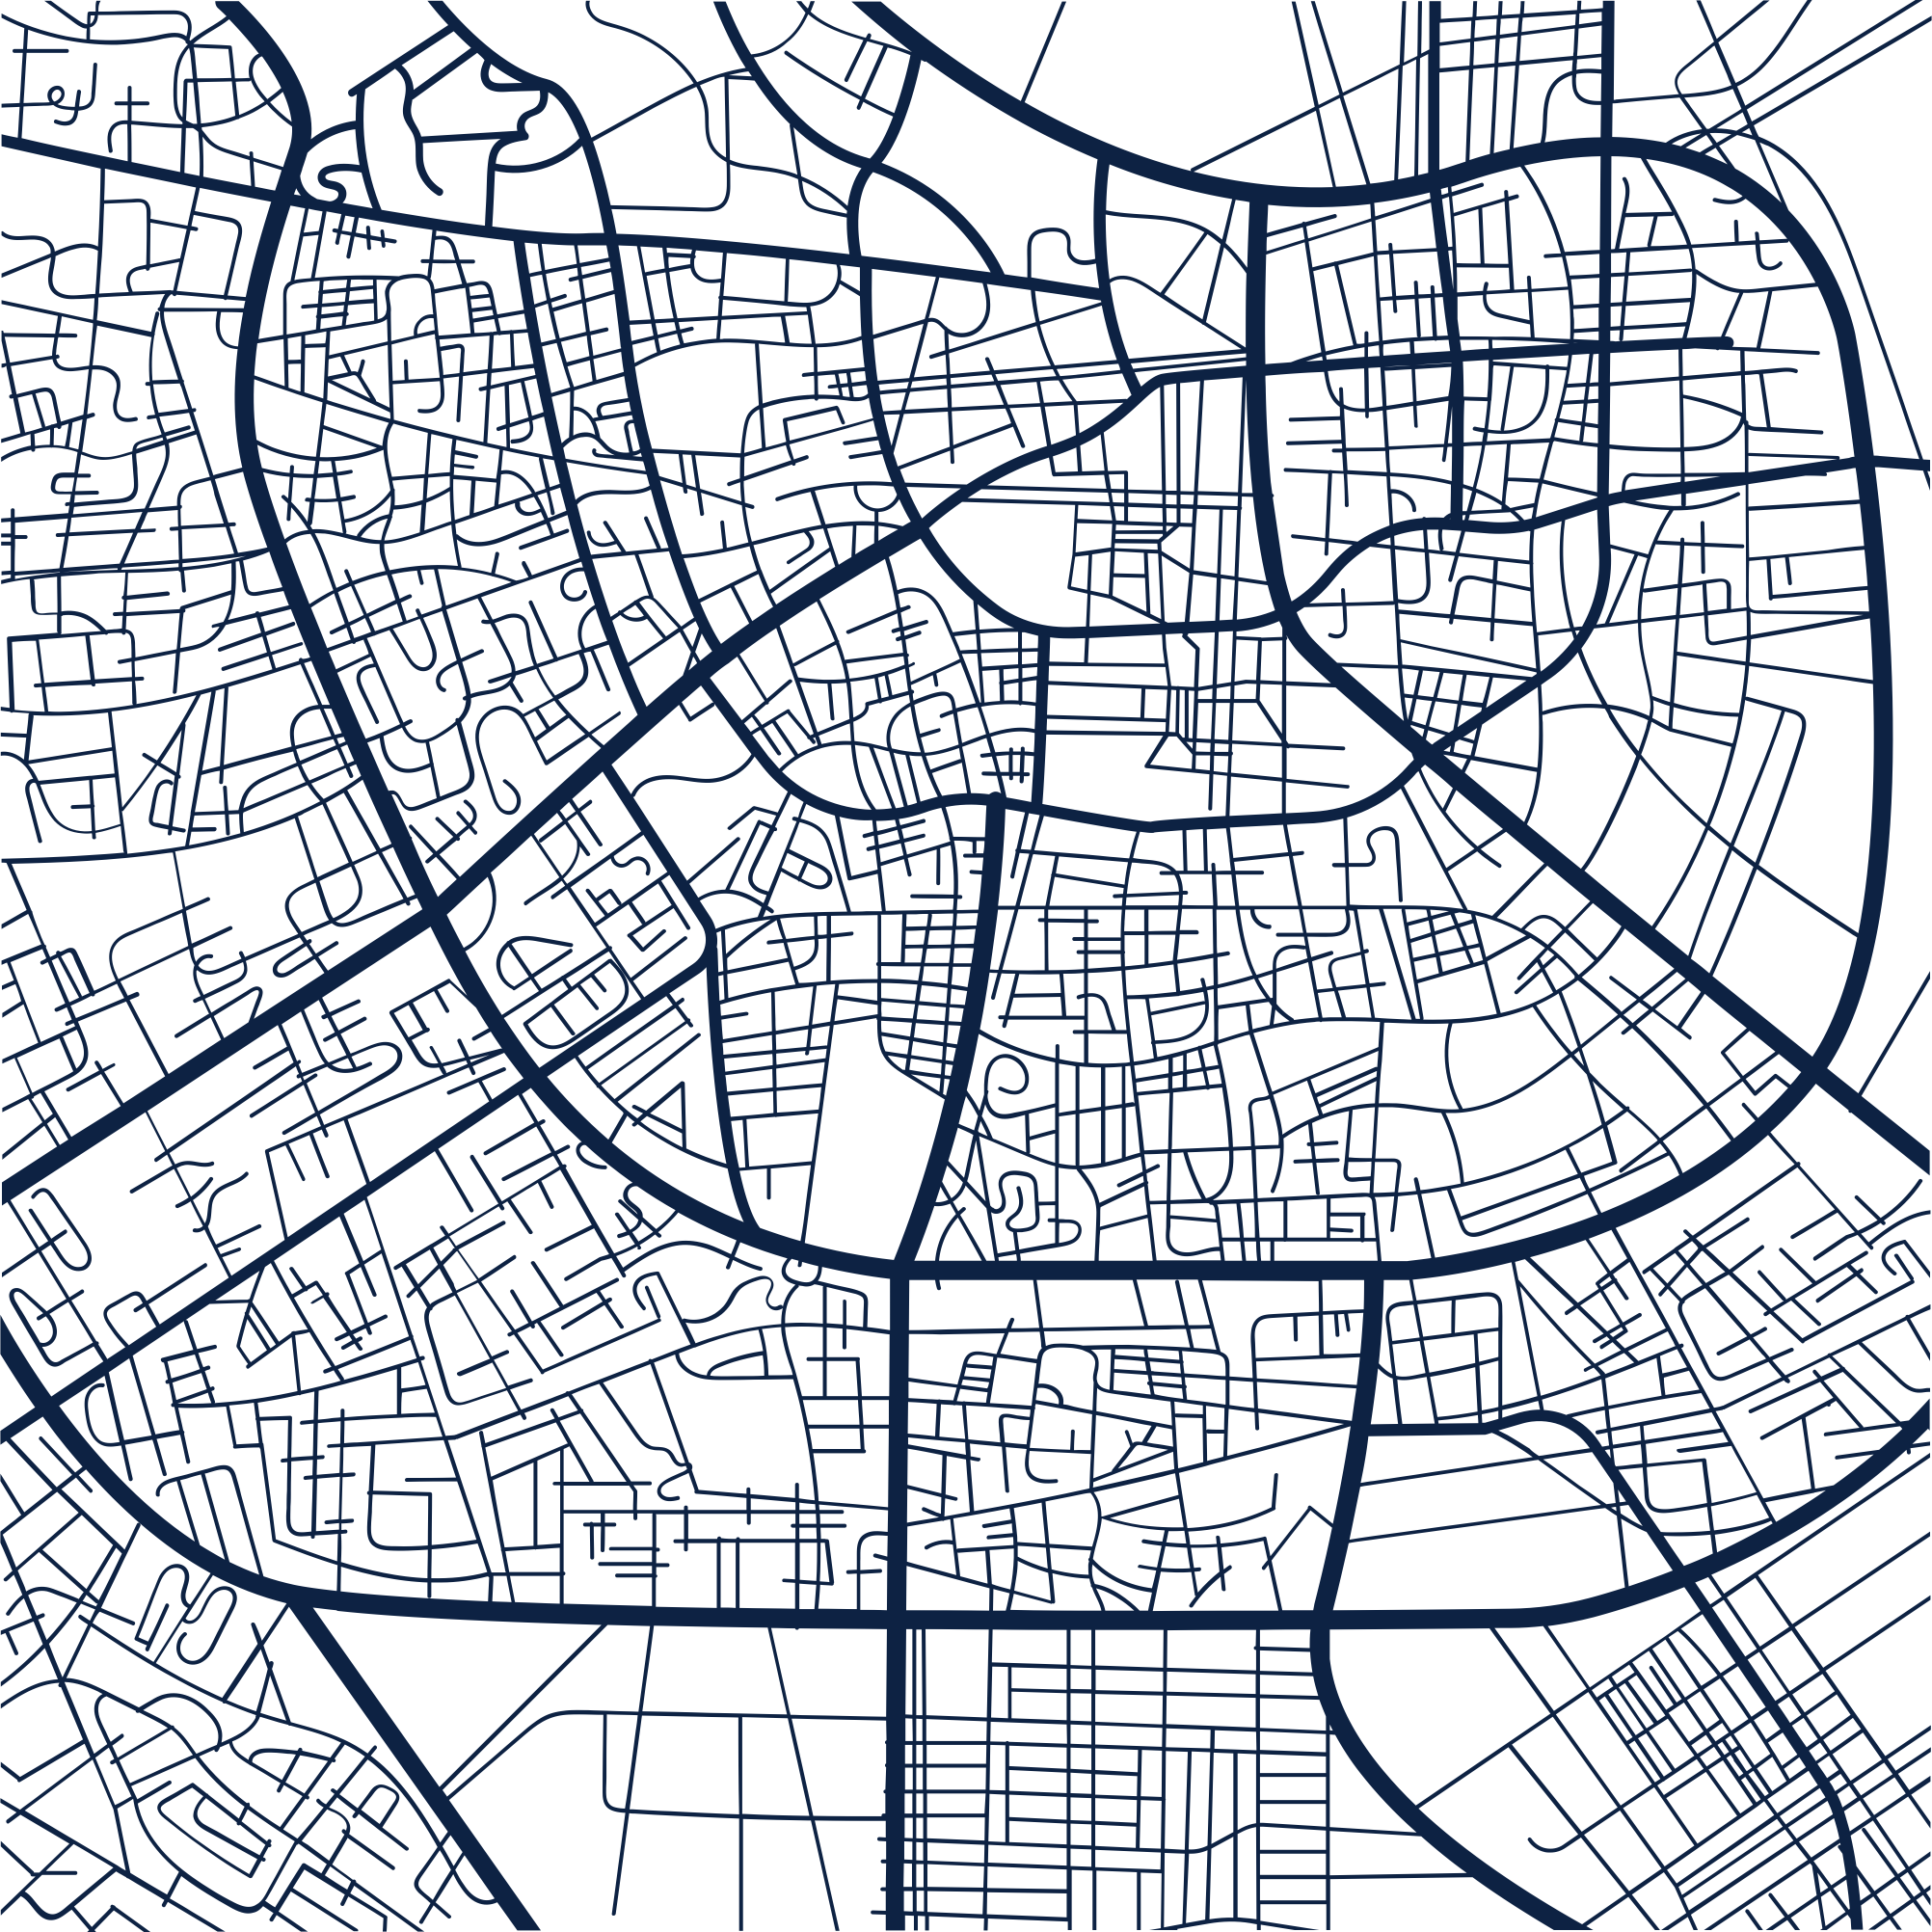
Reasons for setting up the app
•
Enhance User Accessibility
Improve Decision Making
Increase Barber Visibility
User-friendly interface for scheduling appointments with barbers.
Easy selection of services, appointment times, and barber choices
Simplified process for booking appointments.
Incorporation of a rating system
Assistance in making informed decisions in barber choosing
Utilization of others experiences
Platform for barbers to showcase services
Receive customer feedback.
Improve visibility to potential clients.
Notes:
הסיבות להקמת האפליקציה

Slide 4

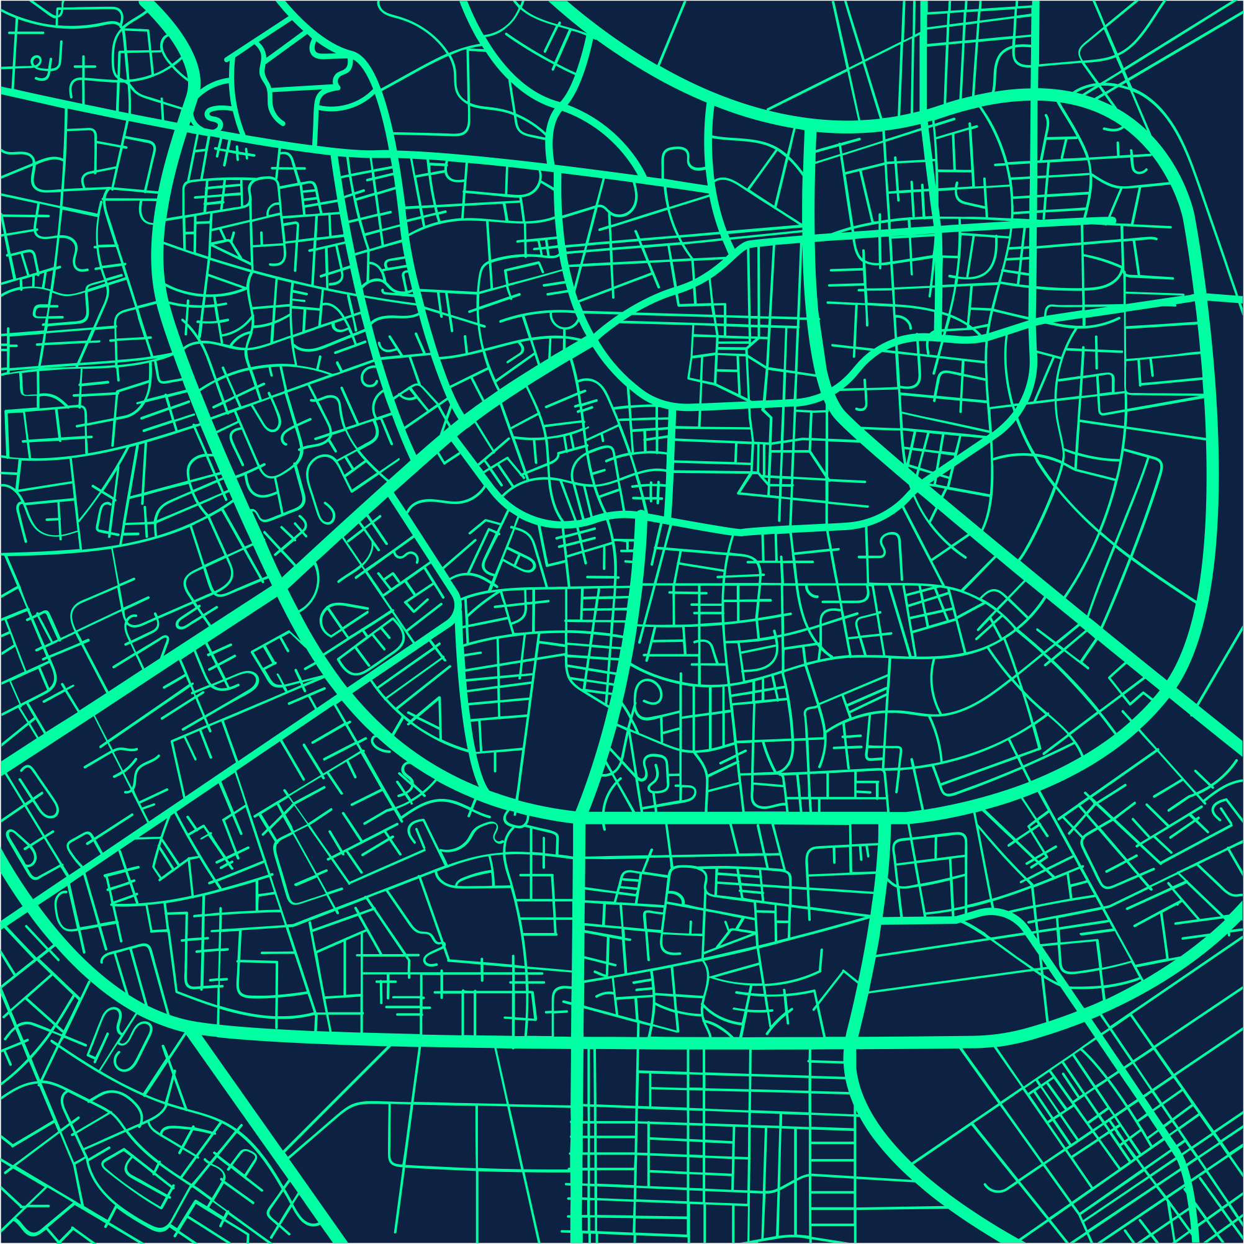
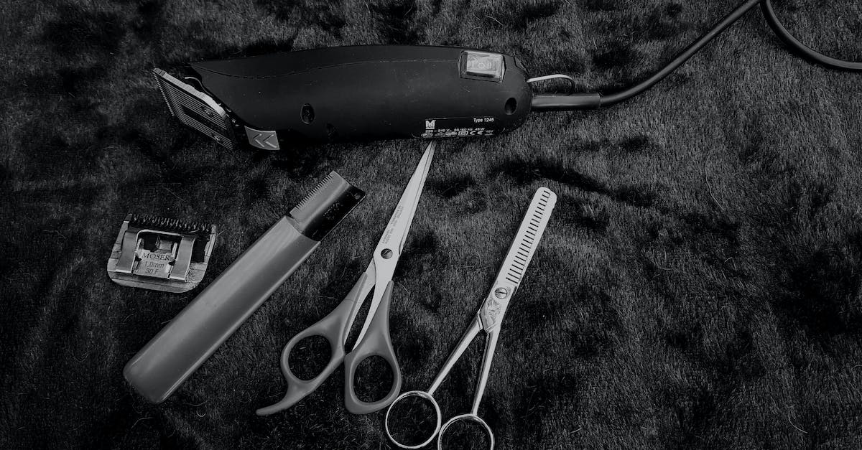
Requirements

Slide 5
Requirements
Functional requirements
Client Functionality:
Barber Functionality:
Appointment order (including Barber choosing. Haircut style and date
Profile view
Displaying all appointments
Rating barber
Edit profile
Log-in
Sign-up
Set Appointment
Profile view
Set Hairstyle
Edit profile
Log-in
Sign-up

Slide 6
Requirements
Non-Functional requirements
Availability: The app is available 24/7
Compatibility: The app is compatible with a wide range of android devices
Usability: The app have an intuitive interface that is easy to navigate
Scalability: The app can handle many users simultaneously without degradation in performance
Security: All user data stored by the app encrypted

Slide 7

Central Features
Log-in
Log as client or barber via Email address
Signup
New users can choose to have barber or client account according their role
Appointment system
Barbers can inform users their job time and clients can set an appointment to their favorite barber
Rating system
After appointment users can give feedback how was the service

Slide 8
UML Diagrams

Slide 9
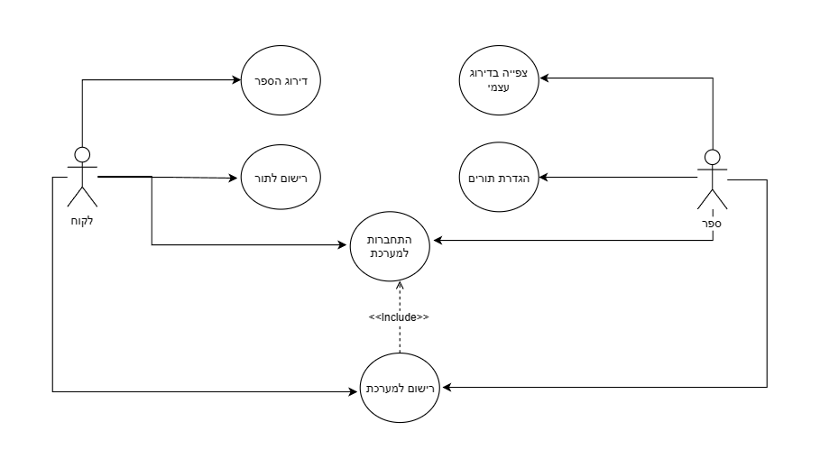
Use case diagram
Description
Relationship between each classes in the project

Slide 10
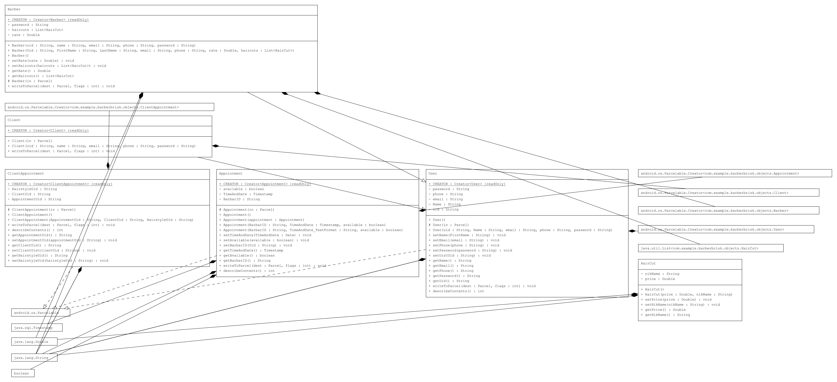
Class diagram
Description
Relationship between each classes in the project

Slide 11
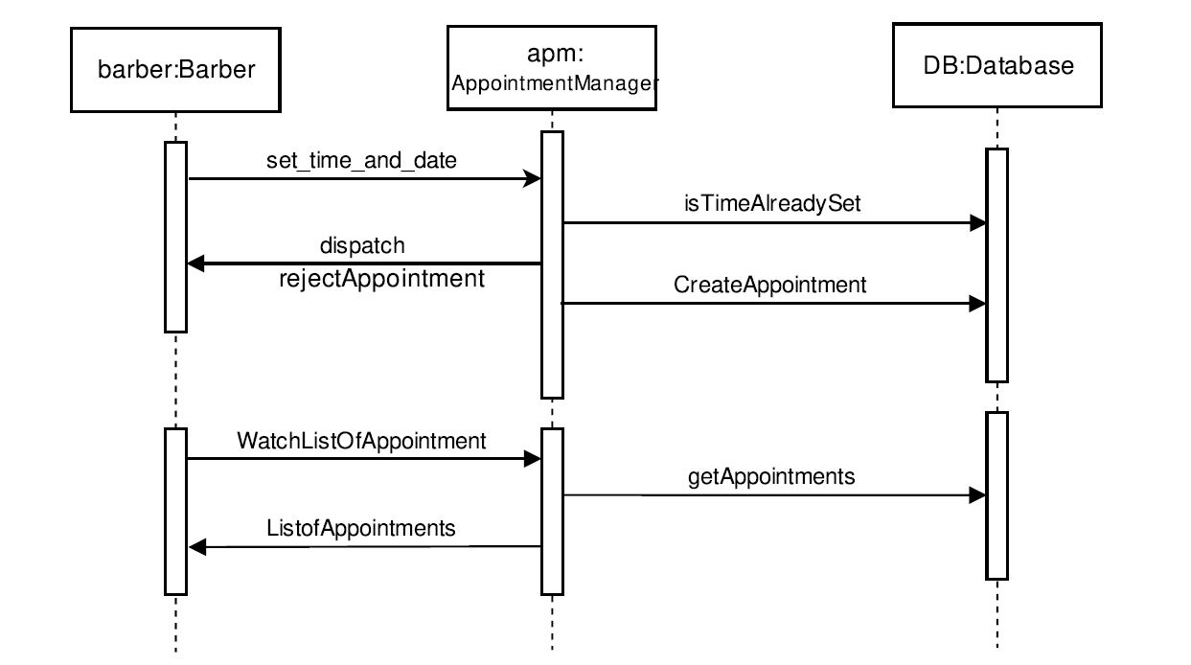
Sequence diagram
Description
Demonstration of setting appointment by the barber

Slide 12
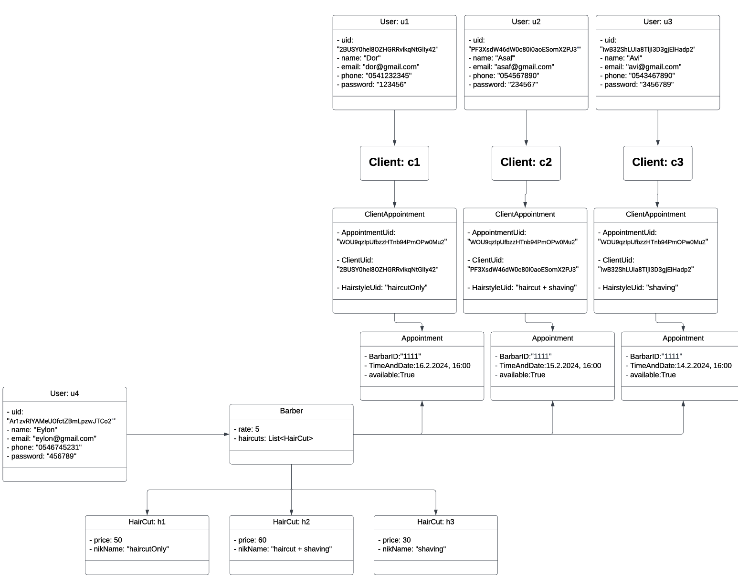
Object diagram
Description
Demonstration of objects flow with examples

Slide 13
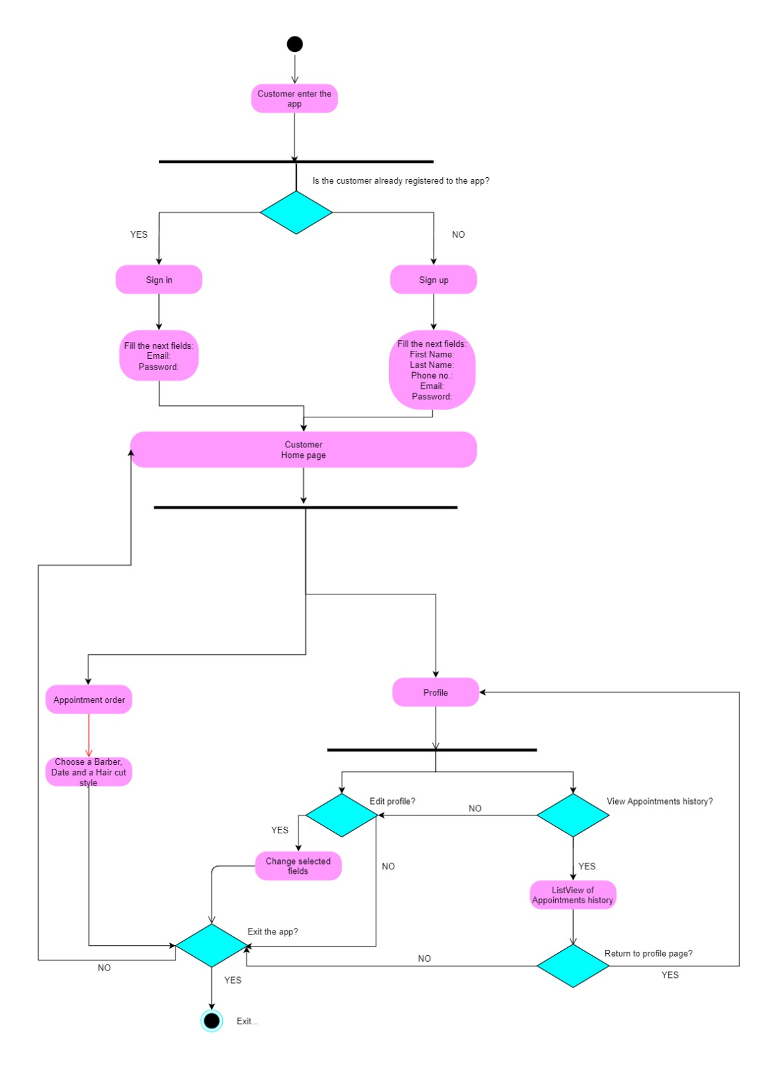
Activity diagram
Description
Flow chart of the main features of the app.

Slide 14
Description
Flow chart of the main features of the app.

Slide 15
App demonstration

Slide 16
•
open screen
•

Slide 17
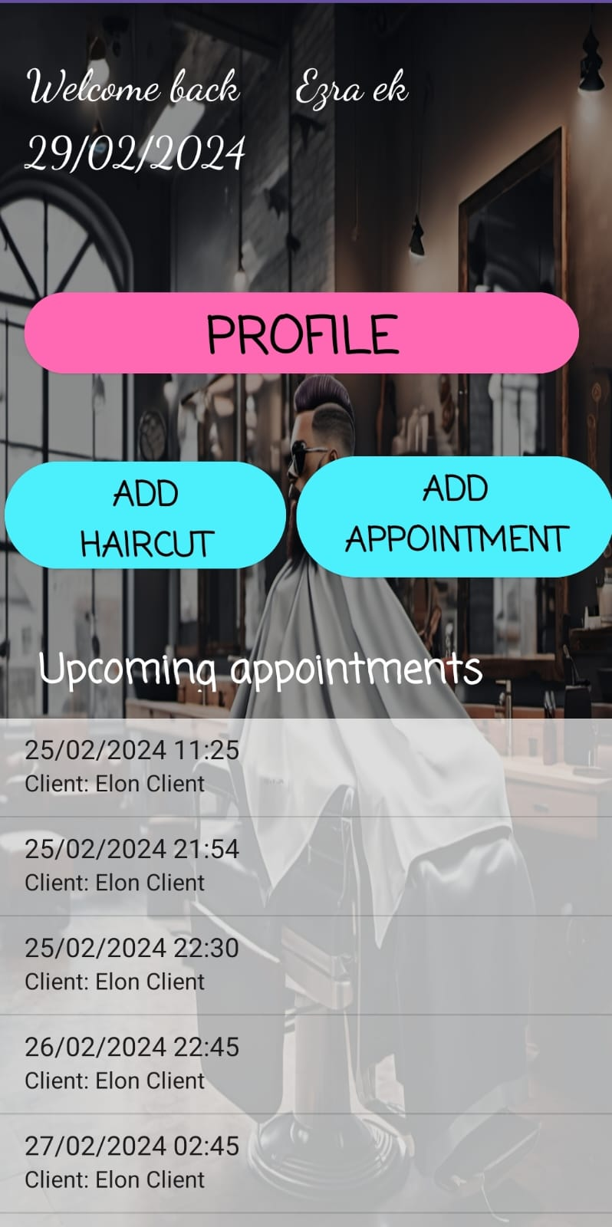
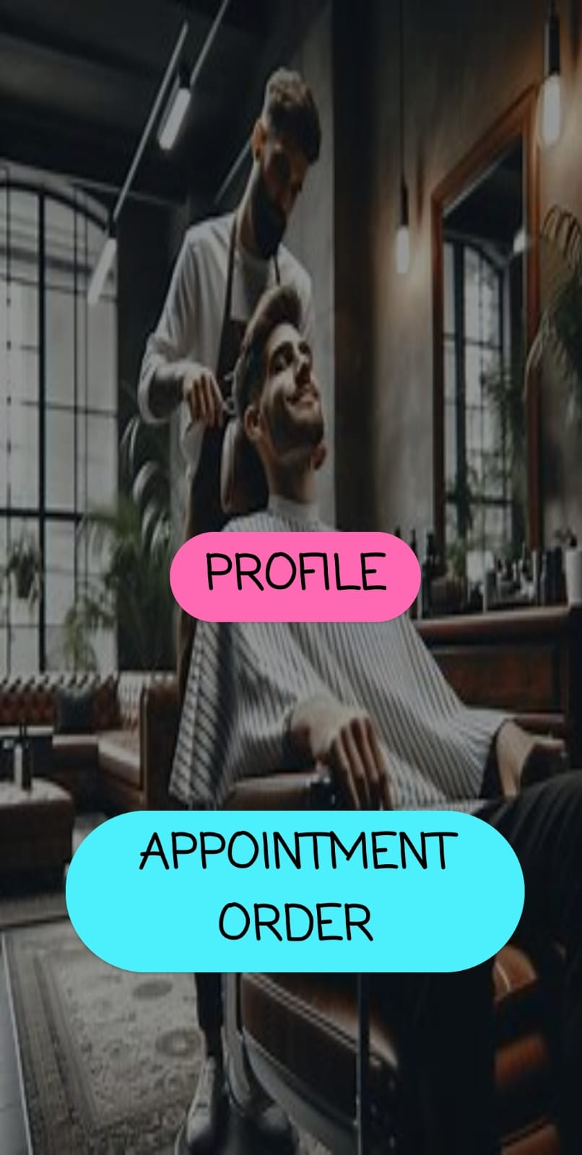
•
•
Barber home page
Client home page

Slide 18
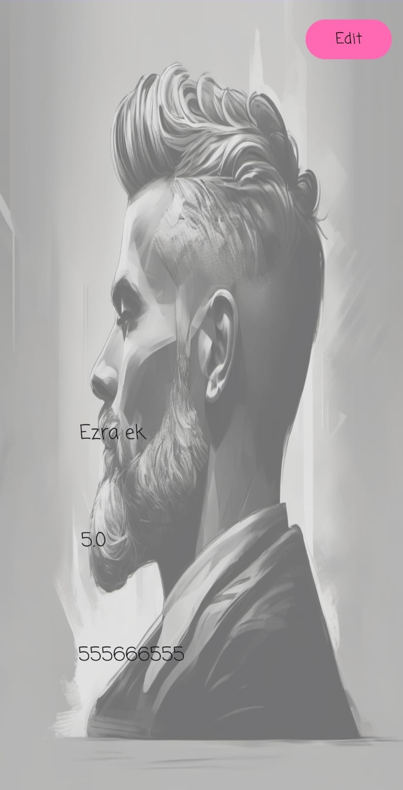
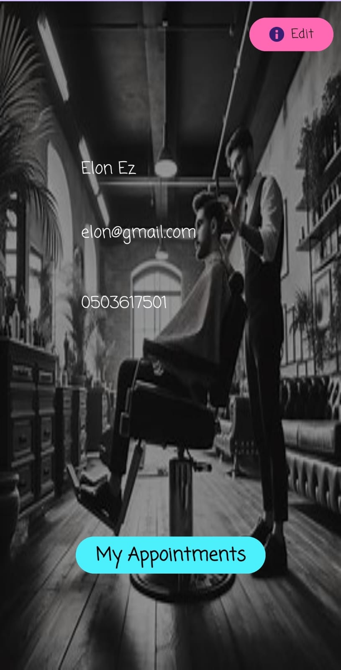
•
•
Barber profile page
Client profile page

Slide 19
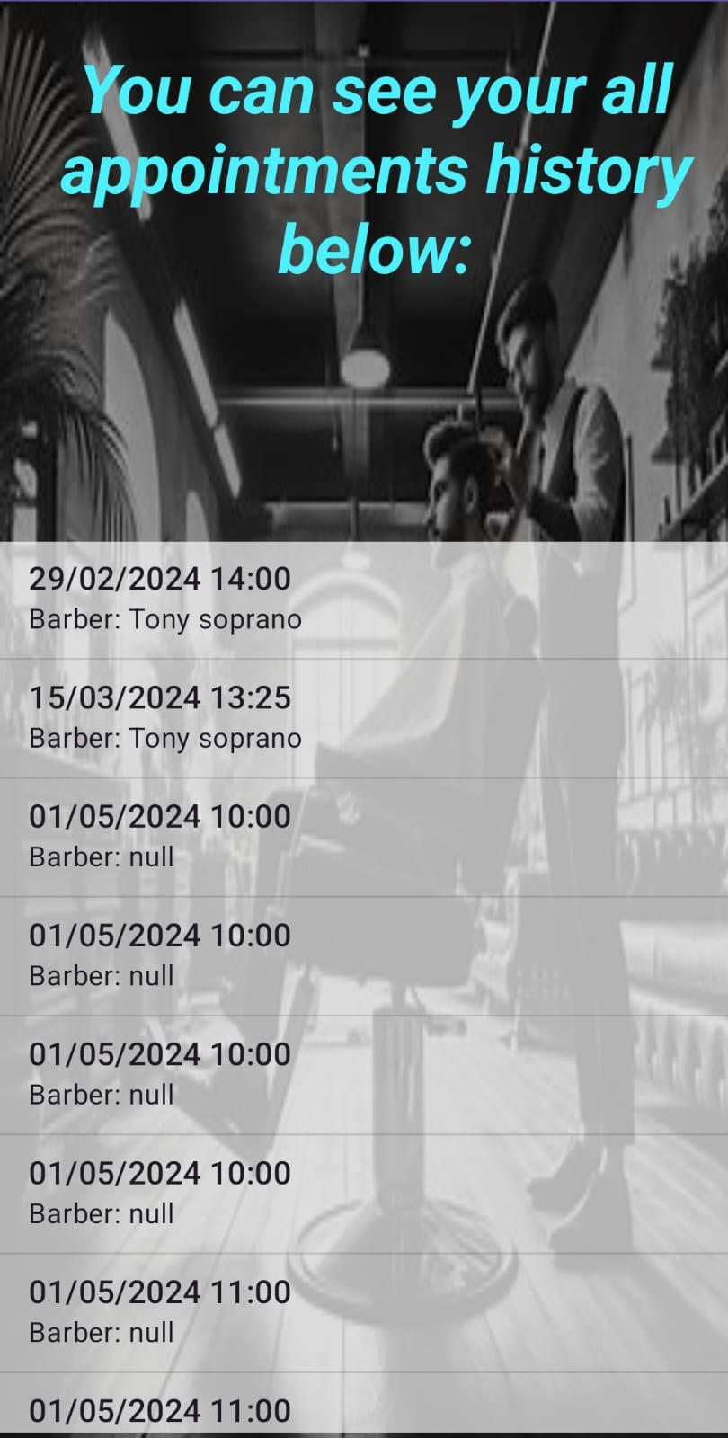
•
Client profile page
Client can watch his appointments

Slide 20
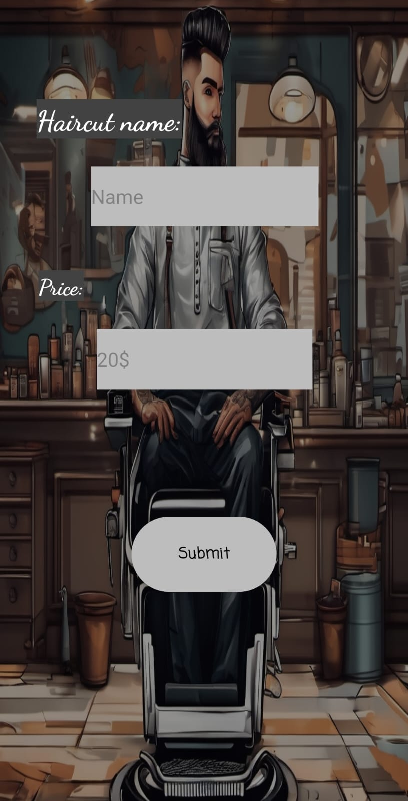
•
Add haircut
Barber can add the haircut he knows
•

Slide 21
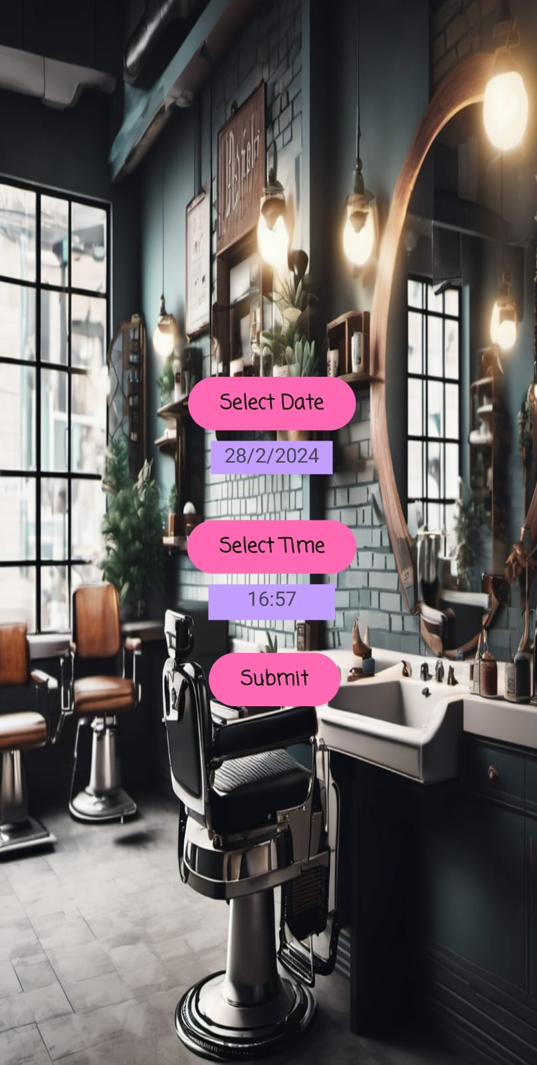
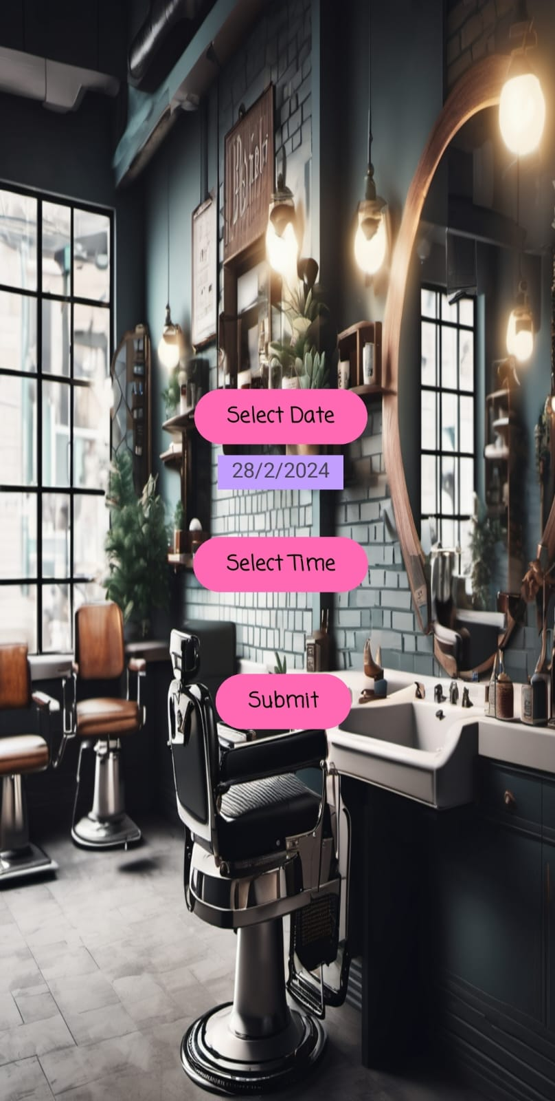
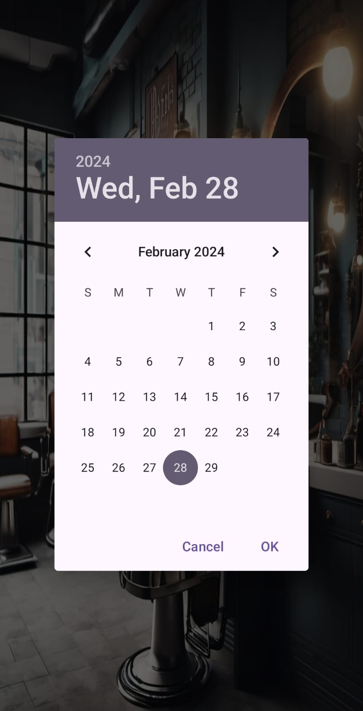
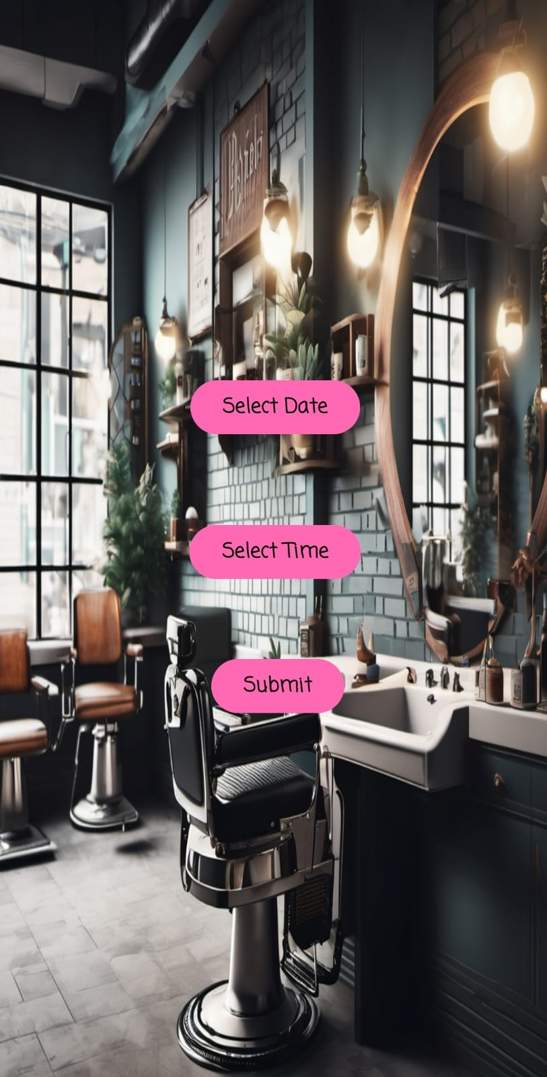
Set appointment by barber

Slide 22
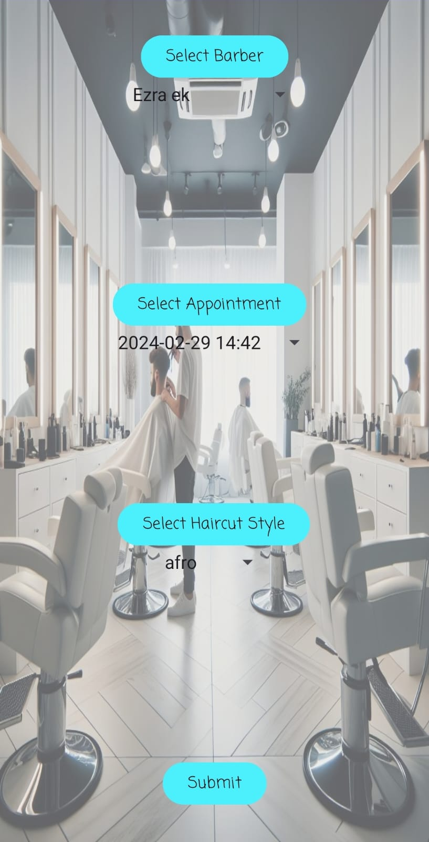
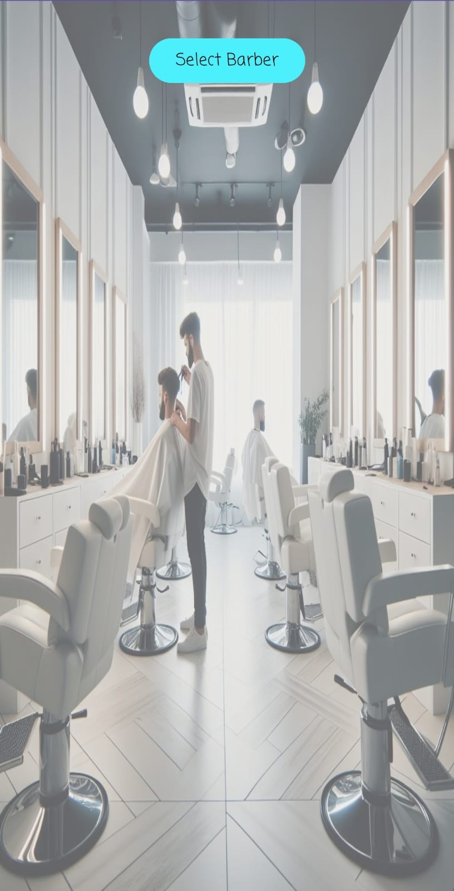
Set appointment by client

Slide 23
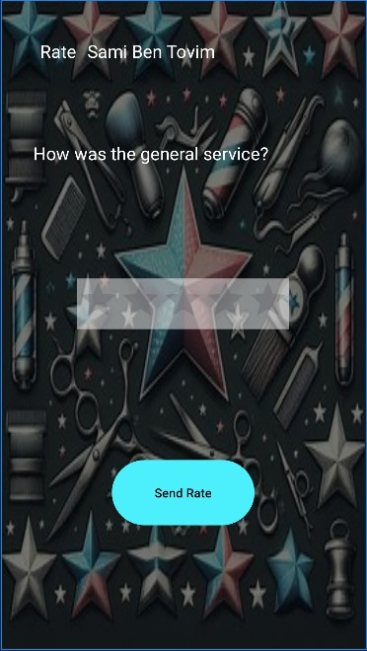
•
Rate your barber
client can rate their barber after the appointment
•

Slide 24
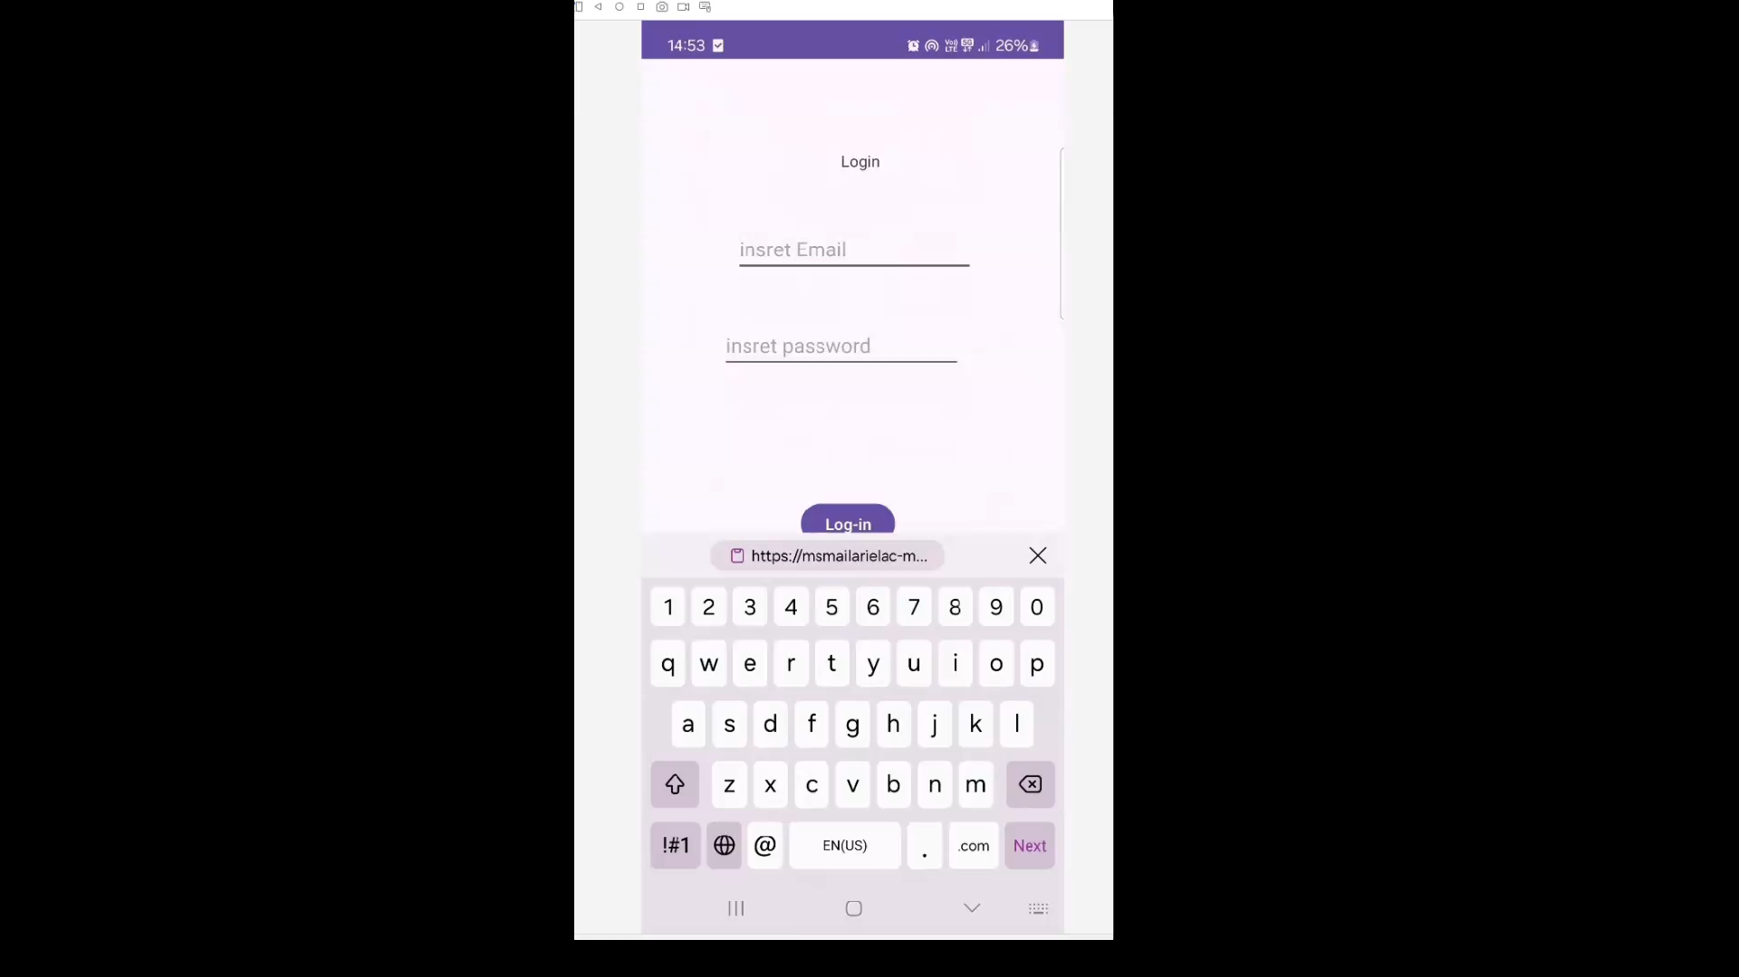
Set an appointment and rating - video example

Slide 25
Technology usage
IDE
Android studio
Database
firebase,
Firestore – for entities
Firebase Authentication – user managment
Development language
Java

Slide 26
Development gaps
AI Chat
Client could have the ability to set appointment by chatting with an AI chat bot
Payment system
Client could have to pay in advance using payment system in order to order an appointment
Canceling appointments
If a user regrets, or cannot arrive, he can cancel the appointment about 4 hours before the start of the appointment.

Slide 27
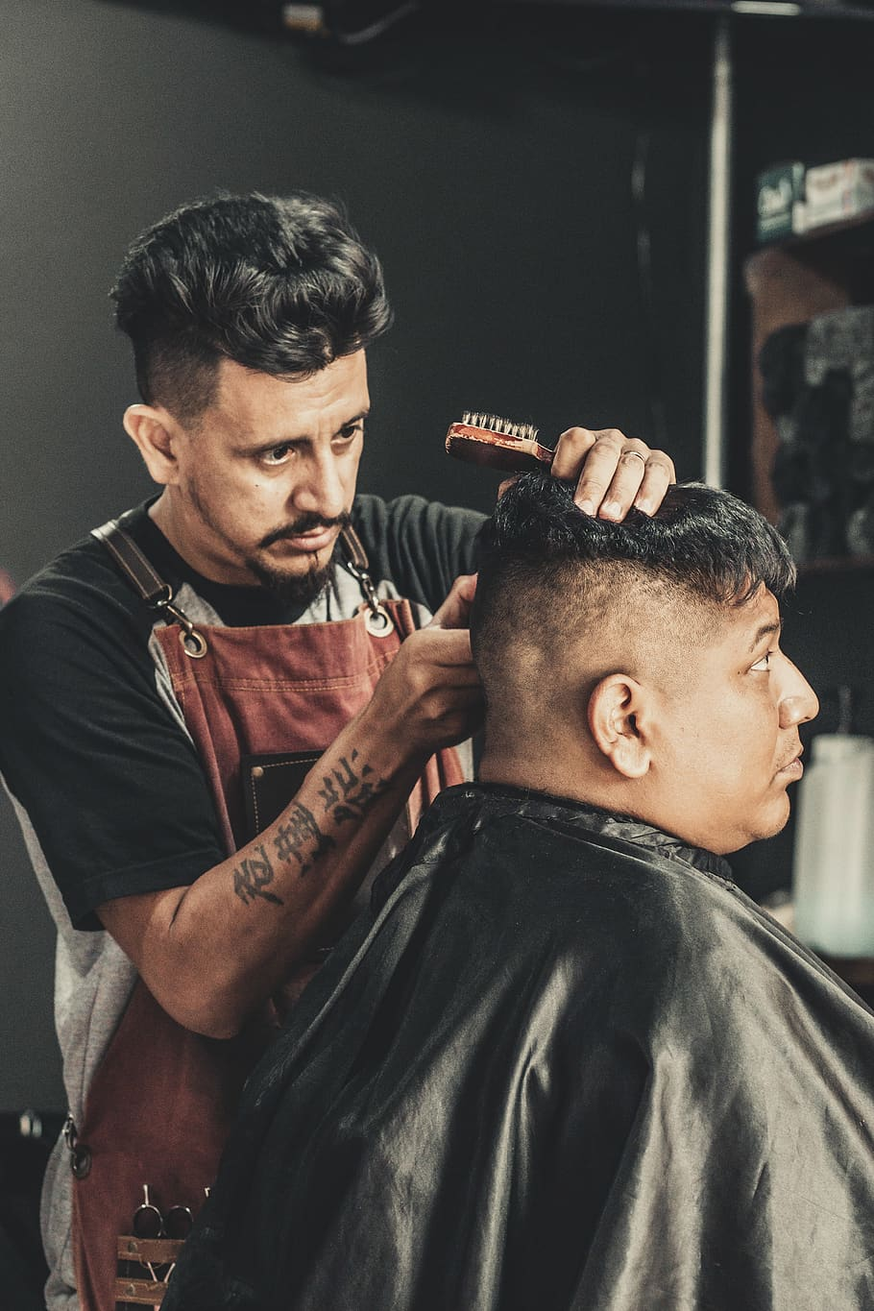



Thank you for listening!
https://github.com/BarberBrisk-team/BarberBrisk
@BarberBrisk
BarberBrisk.com

